Slide 1



Keystone to the Kingdom
Tricks targeting BEST SFICs

Slide 2
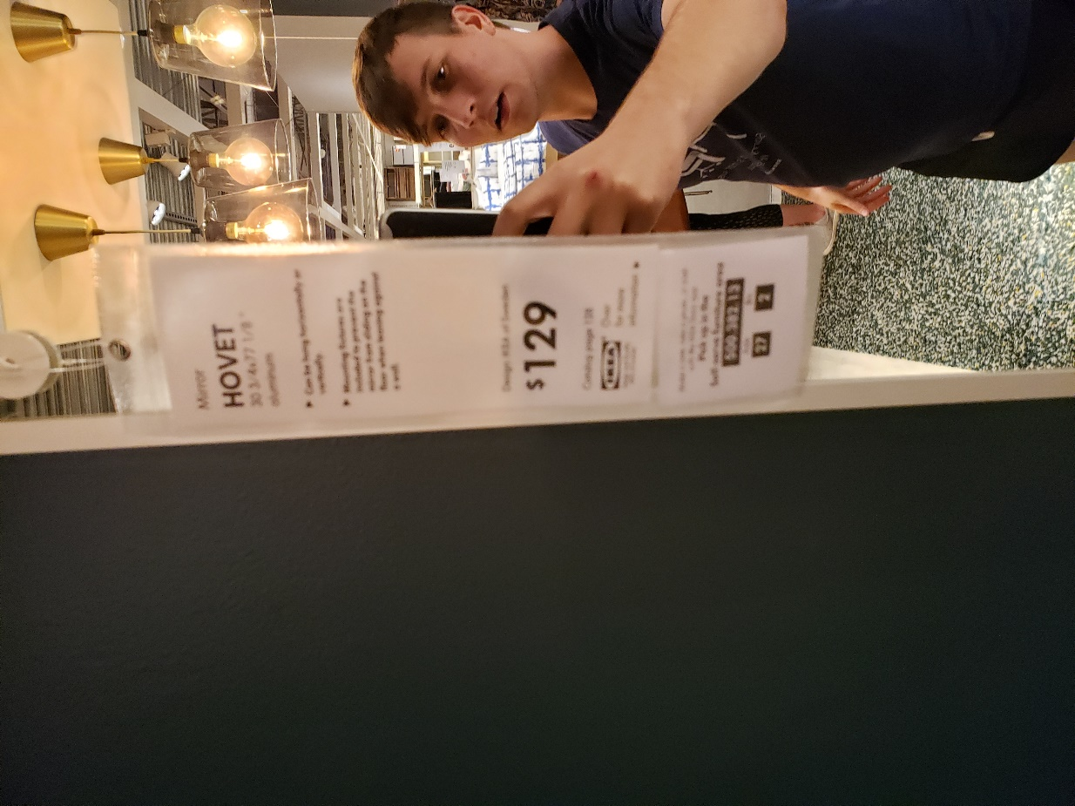





Whoami
Austin Marck
Security Enthusiast
amarck@amarck.com
http://www.amarck.com
Twitter.com/icryo
Hackthebox.eu/profile/23771
*Not a locksmith*
ANTHOLOGY

Slide 3

ANTHOLOGY
Keystone to the Kingdom
What?
This will be a hands-on version of a physical security talk given at Defcon 2019 about targeting SFIC locks. While parts of this lab would be best done with locks and keys, you’ll learn there is more to SFICs than physical attacks. We’ll be focusing mostly on BEST SFICs, but these attacks are largely universal
CTF
More challenges will open once we’ve finished this presentation. Part of this presentation will walk you through a few of the initial challenges.
LABS
CTF Login: pctf.ant.red
Course Materials: p.ant.red
Keystone Web: http://ksw.ant.red:8080
Login: MTStudent Pass: 5Weshouldprocuremorecowbell!
ANTHOLOGY

Slide 4
Agenda
What we will cover
What are SFICs
What are keymarks
SFIC stands for Small Format Interchangeable Core: They are a way for a business to change which key goes to which door quickly. They also provide a means of access control. Sally shouldn’t be able to go into Jim’s room, but the Janitor should be able to go anywhere..
Exactly what they sound like. Keymarks are simply marks put on keys for tracking purposes. When you have a lot of doors that require appropriate access control keymarks help track who has access to what.
Where are SFICs
What can we do
Common locations:
Schools
Office Buildings
Hotels
Very Large Businesses
Some of the attacks we’ll cover:
SFIC Picking
Key Duplication
Lateral Movement
System Decoding
ANTHOLOGY

Slide 5

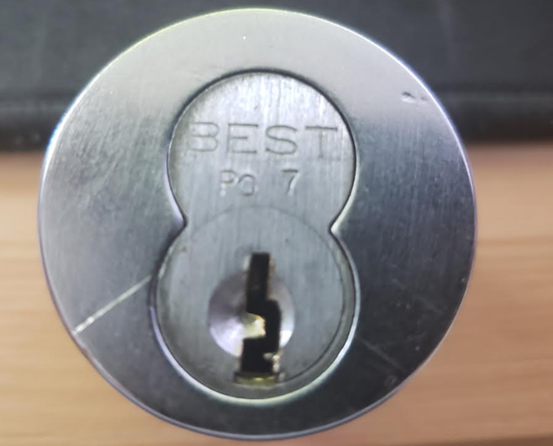
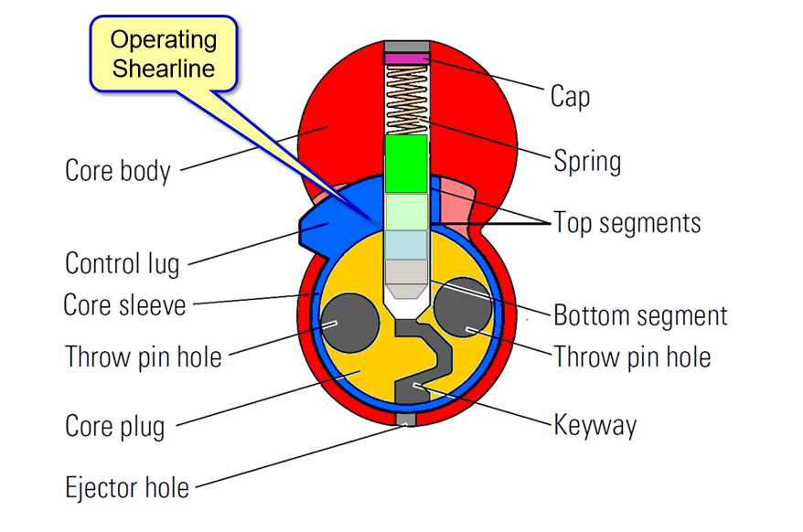
What Are SFICs
Small Format Interchangeable Core
An SFIC
On the Inside
Core Removal
As it would be installed
Segments
Creative director
Note the CoreMark on this SFIC. ‘PG7’, a PG7 Coremark should be operable by a PG7 operation key or a “master” to the PG7 key.
Master wafers are segments that allow the key to accept multiple operational keys as well as a “control key” which can operate the “control lug”
Control Lugs keep the core within the cylinder case. If a core is removed the door can be opened or a new core could replace the old one.
ANTHOLOGY

Slide 6

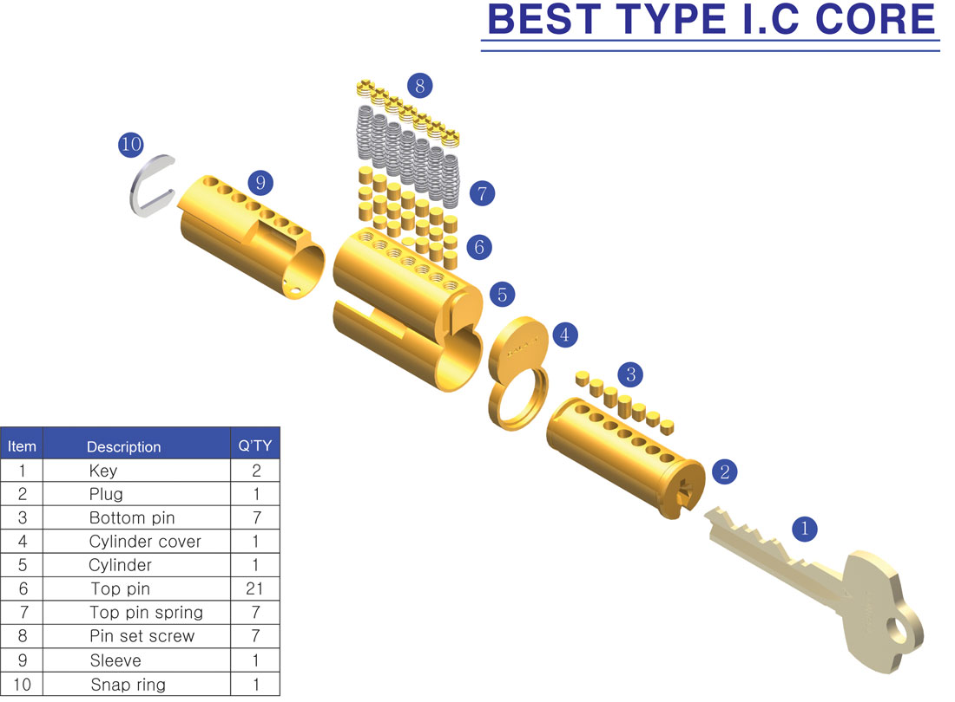
I.C Core
Casing and housing
ANTHOLOGY

Slide 7
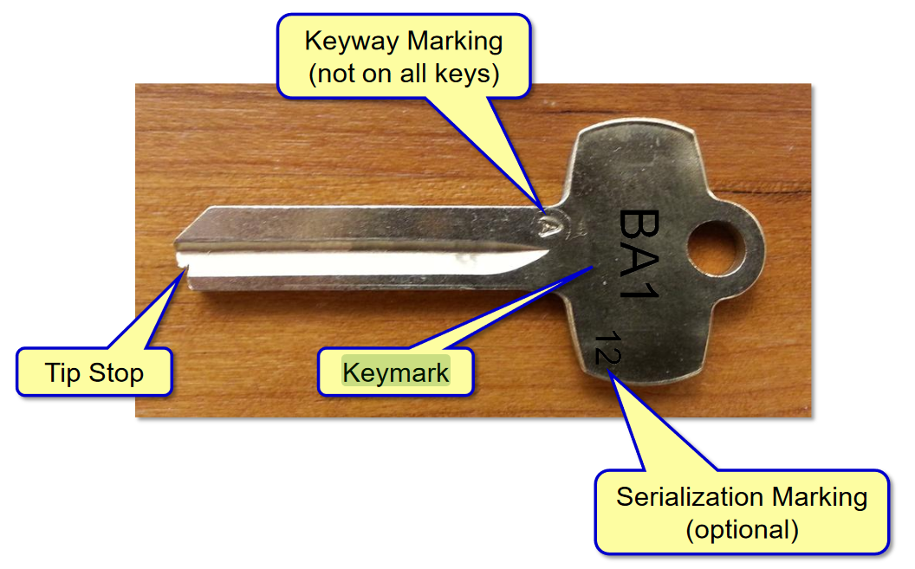
SFIC Keys
Parts of a key
Keymark
Keymarks denote which key this goes to within a system and which door(s).
Keyway Marking
Keyway Marking Denotes the type of keyway used.
Serialization
Optional: but useful if you have multiples of a key going to different people
Tip Stop
There is some variance in the types of tips used by different SFICs.
ANTHOLOGY

Slide 8
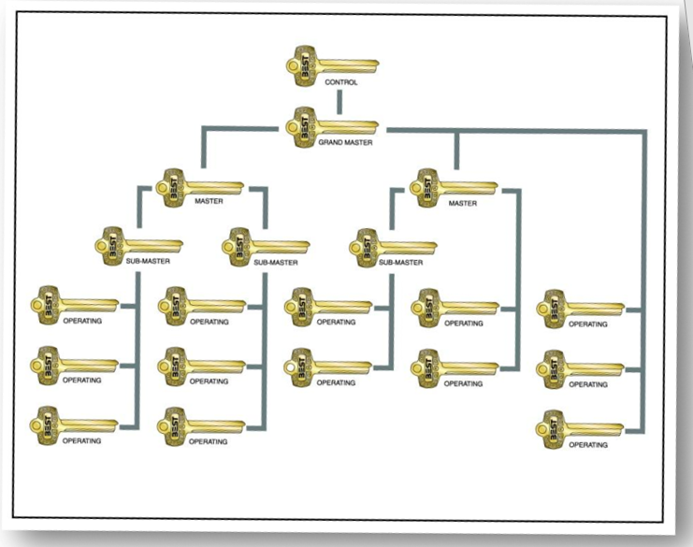
BEST Key Systems
Parts of a key
High value keys
CT- Control Core removal and open any door
GM- Grand Master Operates any door
MA,MB,MC,MD – Master Master of A, B, C ,D …
Operating Keys
Operating Keys are useful for opening a door within a system. These are the keys you’d typically give an authorized user for their office, the server room, or another sensitive area.
ANTHOLOGY

Slide 9
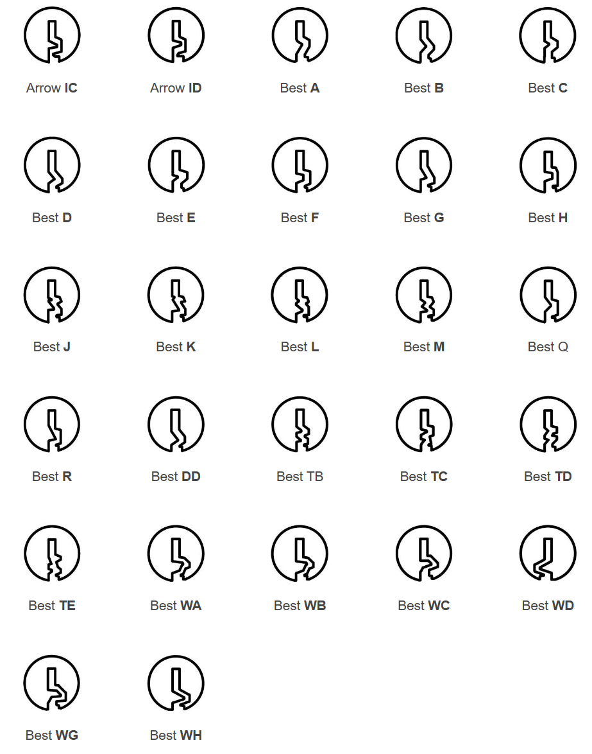
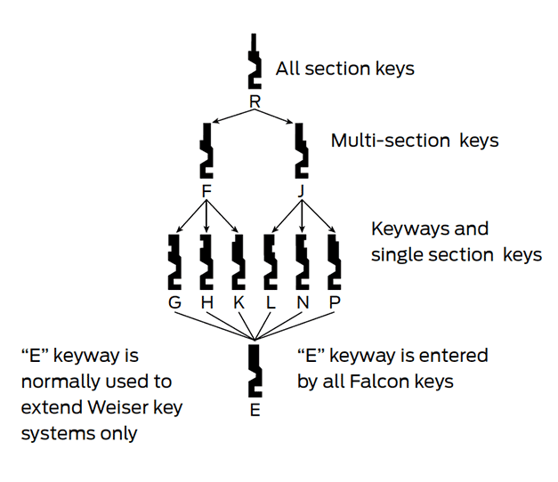
Keyways
Parts of a key
BEST Family
Keyways
SFIC keyways are intended to increase the access complexity and can be used add another level of hierarchy.
Falcon Multiplex Family
Multi-keyway keys
Some keys can operate multiple types of keyways. Take for example the WA,WB,WC keys shown to the right. When in doubt multi-way keys may also provide additional lateral movement opportunities
ANTHOLOGY

Slide 10
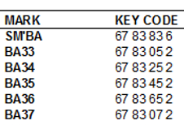
Lateral Movement
From a codebook
Submaster
Submasters are privileged keys that can open all doors below their level within the key hierarchy
Keymarks
Keymarks denote which keycode was cut into the key (SM’BA)
Pattern Recognition
Note the 5th and 6th columns of the keycode.
ANTHOLOGY

Slide 11
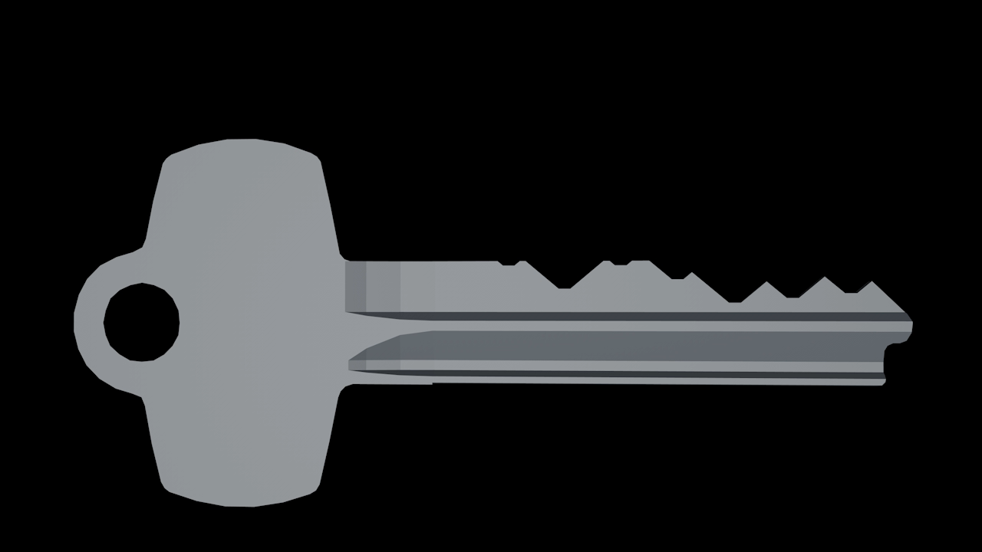
Lateral Movement
From a codebook
ANTHOLOGY

Slide 12
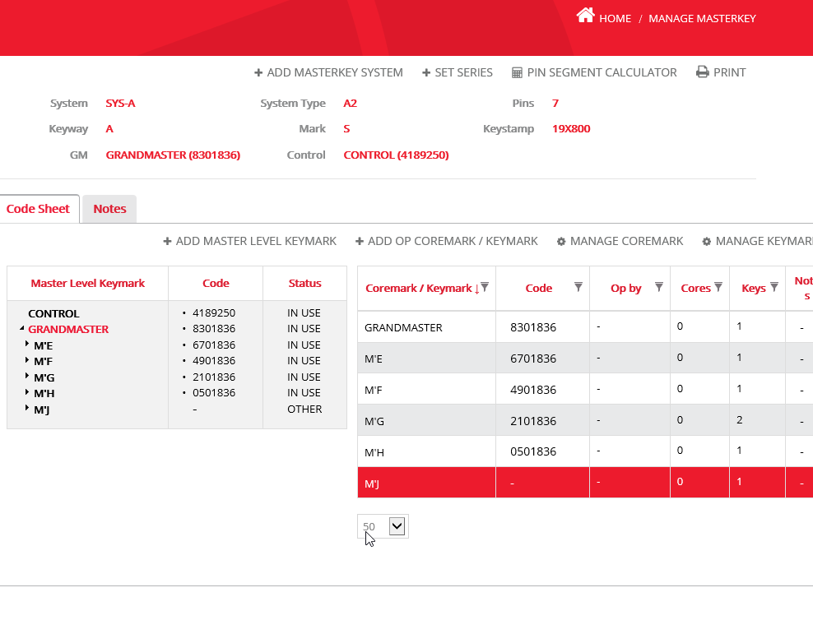
Keystone Web
With AD integration!
Keystone Web
Keystone Web “…helps the user manage keys and core records for multiple personnel throughout various locations. This product allows importing and appending data, mass deletes for employees, keys and door key data, performance improvements in searches and finders, and an activity log that tracks user transactions. ”
ANTHOLOGY

Slide 13
CTF Walkthrough
Navigate to : pctf.ant.red & ksw.ant.red
ANTHOLOGY

Slide 14
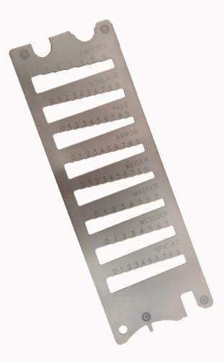

Key in Hand
Using tools
Decoding Tools
Useful for attempting to decode a key intended to be used with a door. Better yet, useful to find the control key associated with a system. If an attacker can get a core in hand then they can decode a key which should open every door in that system.
Calipers
Using calipers measure the length of the top pin
ANTHOLOGY

Slide 15
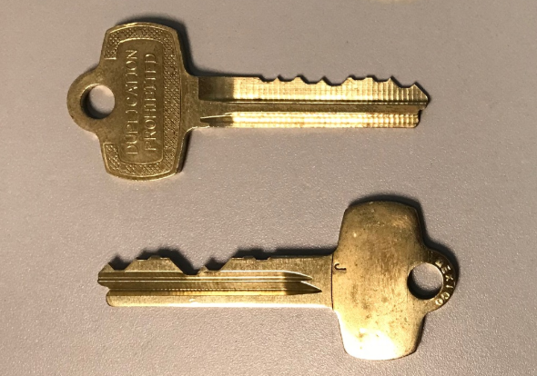
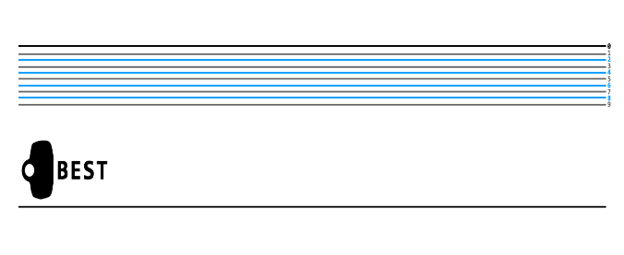
Key in Photo
Using a decoding chart
Image Overlay
Useful for attempting to decode a key intended to be used with a door. Better yet, useful to find the control key associated with a system. If an attacker can get a core in hand then they can decode a key which should open every door in that system.
Apps
Snap Decoder
https://play.google.com/store/apps/details?id=com.whsoftware.snapdecoder&hl=en_US
ANTHOLOGY

Slide 16
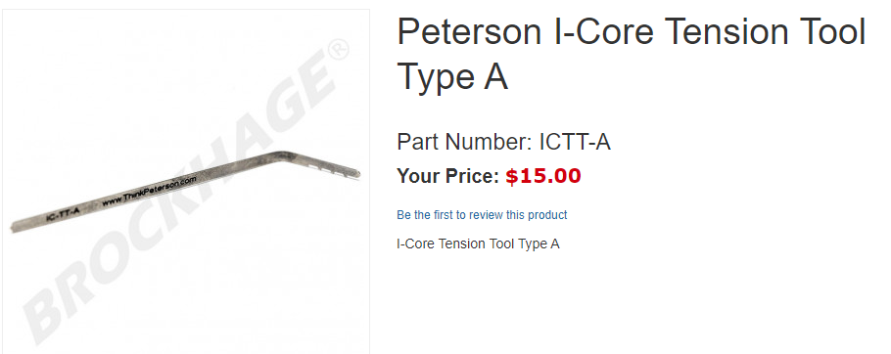
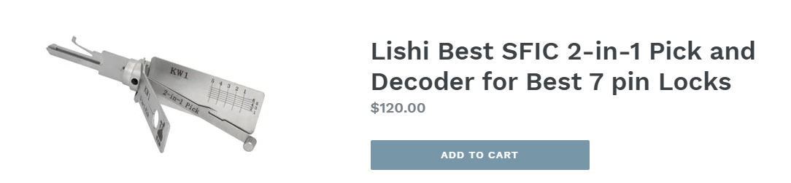
Core in Door
SFIC Tools
Core Tension provided by a control sleeve tensioning specialty tool like the Peterson I-Core can increase your likelihood of successfully picking a lock to “control”
The Lishi SFIC pick tells you the bitting as you pick the lock.
Or… don’t…
“Bitch Picking” isn’t my name for it, but other prolific pickers have had a ton of success attacking SFICs by ramming their picks up and down. Sometimes even getting lucky enough to pick to control.
ANTHOLOGY

Slide 17
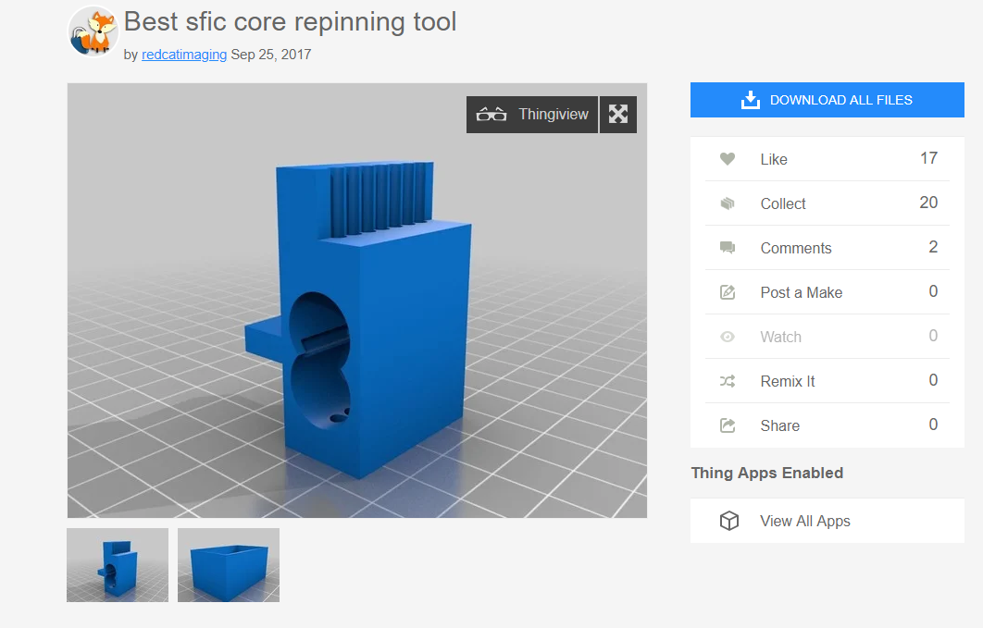
Core in Hand
SFIC Repinning
SFIC Pin Extraction
Cheap 3D printed SFIC core repining tool developed by redcatimaging. Metal repining tools can cost over $100. This is a cheap and effective way to remove pins. You’ll need a hammer and a small piece of metal.
An STL is included in your course material.
ANTHOLOGY

Slide 18
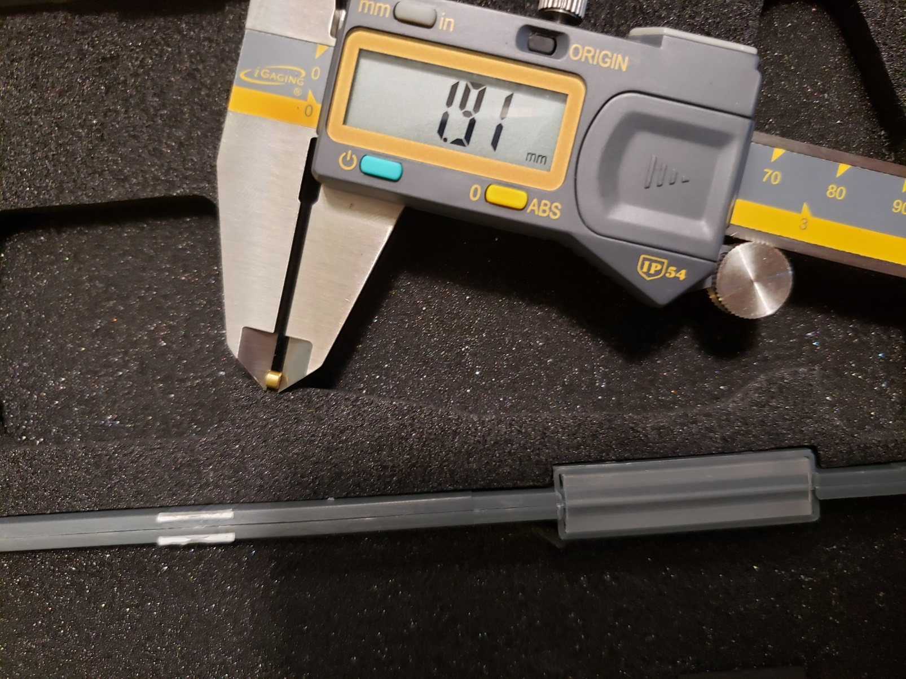
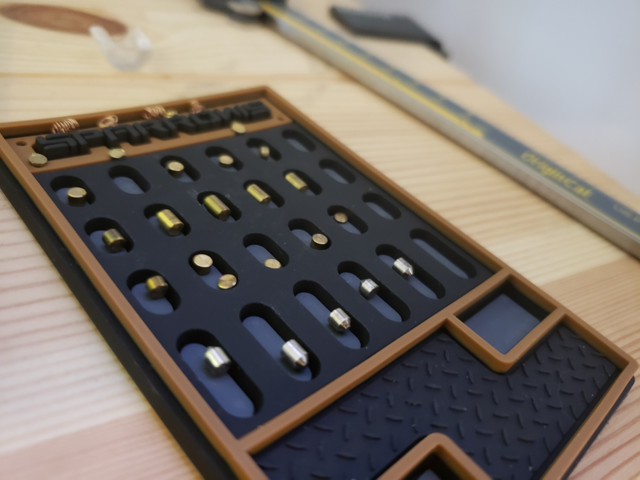
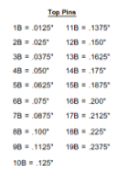
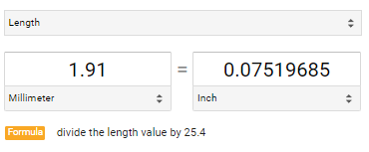
Decoding Pins
Measuring Pins
Pin Extraction
Hammer out the pin caps and extract each of the pins from the core.
Measure
Top pin number 2 appears to be a “6B”
ANTHOLOGY

Slide 19
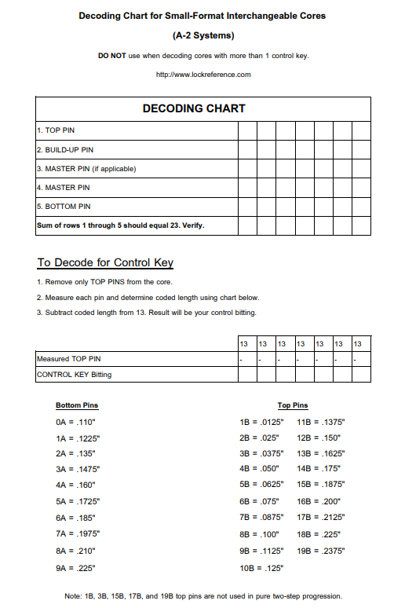
Decoding Pins
Using a decoding chart
Decoding Chart
Useful for attempting to decode a key intended to be used with a door. Better yet, useful to find the control key associated with a system. If an attacker can get a core in hand then they can decode a key which should open every door in that system.
Pull it all together
To decode subtract 13 from the length to receive your final control bitting.
ANTHOLOGY

Slide 20
QUESTION AND ANSWER SESSION
Q &A
YOU ARE NOW FREE TO ASK ANY QUESTIONS
ANTHOLOGY

Slide 21
THANK YOU FOR COMING

